Slide 1

Project Title - Seasonal Agriculture Performance Analysis
Name: Suyash Narendra Patil
College Name- Vishwakarma University
AICTE STU ID : STU6a60c7f42cd921784727540

Slide 2

PROBLEM STATEMENT
Agricultural activities are influenced by seasonal variations in environmental conditions, farming practices, resource availability and market conditions. As a result, agricultural performance may differ from one season to another.
However, raw agricultural data does not clearly explain how agricultural performance changes across seasons or what patterns can be observed in different seasonal conditions.
The problem is to analyze the given agricultural dataset and investigate seasonal differences in agricultural performance by identifying meaningful patterns, trends, relationships and variations within the available data.

Slide 3
Project Description This project analyzes agricultural data across Kharif, Rabi, and Zaid seasons to identify seasonal variations in crop yield, production, environmental conditions, resource usage, and economic performance. Using Python, Pandas, NumPy, Matplotlib, and Seaborn, the dataset is cleaned, explored, and visualized to discover meaningful patterns and relationships. Statistical analysis is used to evaluate significant seasonal differences, while correlation and outlier analysis help identify important factors and unusual observations. The project concludes with evidence-based insights and recommendations for better seasonal agricultural planning and resource management.

Slide 4

WHO ARE THE END USERS?
Farmers – To understand which seasons, crops, and farming practices show better yield, profitability, and resource efficiency.
Agricultural Planners & Government Departments – To support seasonal agricultural planning and identify areas that may require attention or resources.
Agricultural Researchers – To study relationships between environmental conditions, farming practices, resources, and crop performance.
Agribusinesses & Agricultural Companies – To understand production, resource usage, market performance, and seasonal trends.
Agricultural Consultants – To use data-driven insights when advising farmers about crop and seasonal planning.

Slide 5

Technology Used
Python – Main programming language for data analysis
Google Colab – Cloud-based environment for developing and running the Jupyter Notebook
Pandas – Data loading, cleaning, transformation, and analysis
NumPy – Numerical calculations and data processing
Matplotlib – Data visualization and charts
Seaborn – Statistical visualizations and graphical analysis
SciPy – Statistical analysis and hypothesis testing

Slide 6
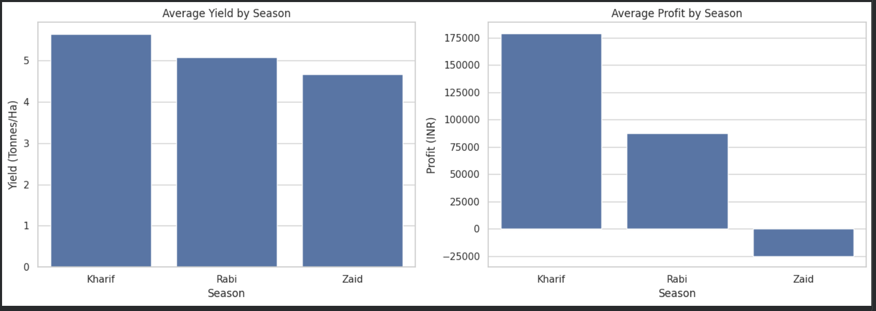
RESULTS

Slide 7
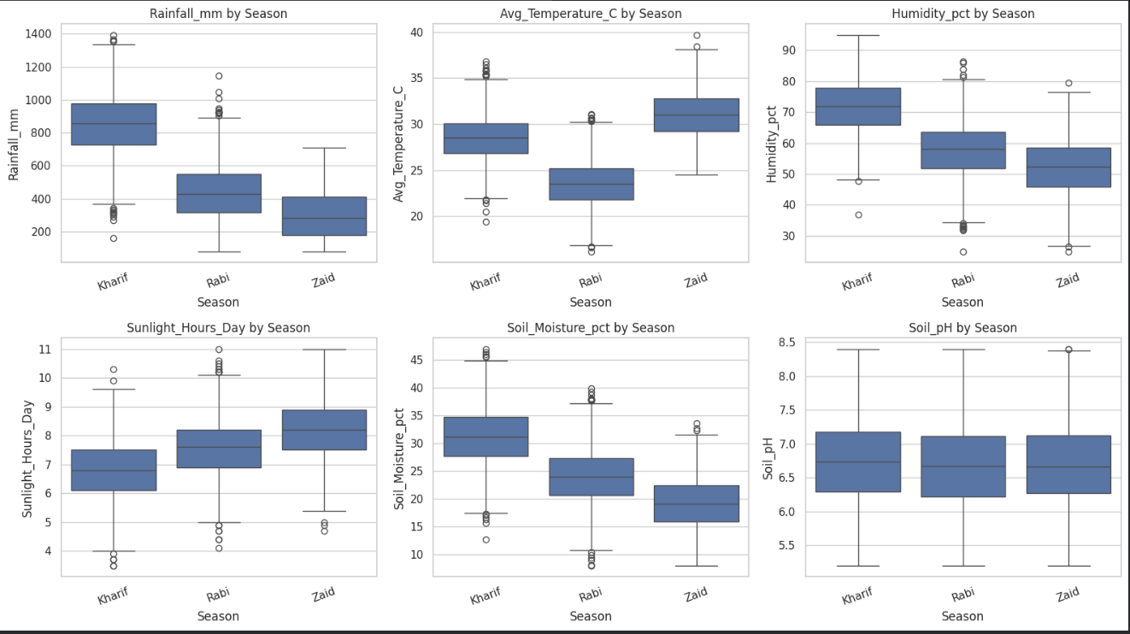
RESULTS
[Add screen shots of your code ]

Slide 8
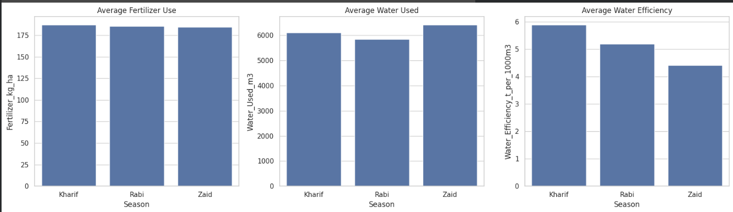
RESULTS

Slide 9
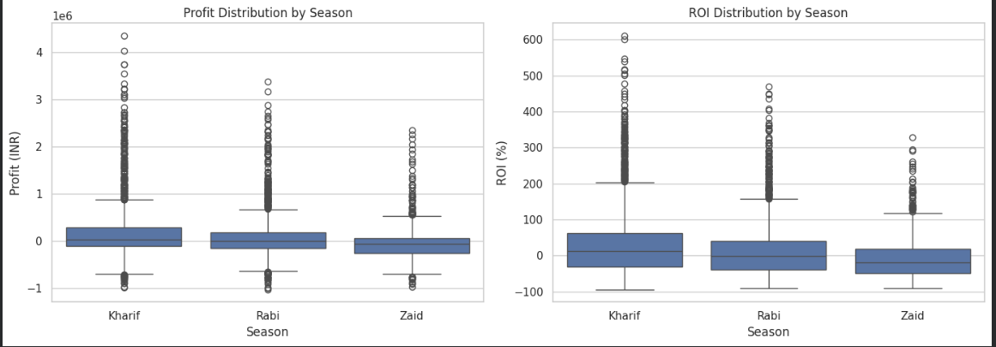
RESULTS

Slide 10
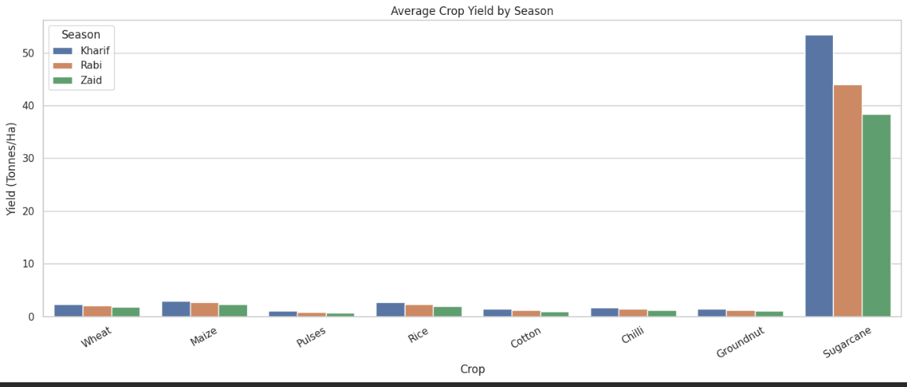
RESULTS

Slide 11
Future scope
Predictive Analytics: Develop machine learning models to predict crop yield and agricultural performance for upcoming seasons.
Weather Integration: Integrate real-time weather data such as rainfall, temperature, humidity, and weather forecasts.
Crop Recommendation: Build a recommendation system to suggest suitable crops based on season, soil conditions, and environmental factors.
Smart Resource Management: Predict and optimize water, fertilizer, and pesticide requirements to reduce resource wastage.
Regional Analysis: Expand the system to provide detailed agricultural insights for different states, districts, and geographical regions.
Real-Time Dashboard: Develop an interactive dashboard using Power BI, Tableau, or a web application for easier monitoring and decision-making.

Slide 12
GitHub Link
https://github.com/suyashpatil26/Seasonal-Agriculture-Performance-Analysis-.git

Slide 13
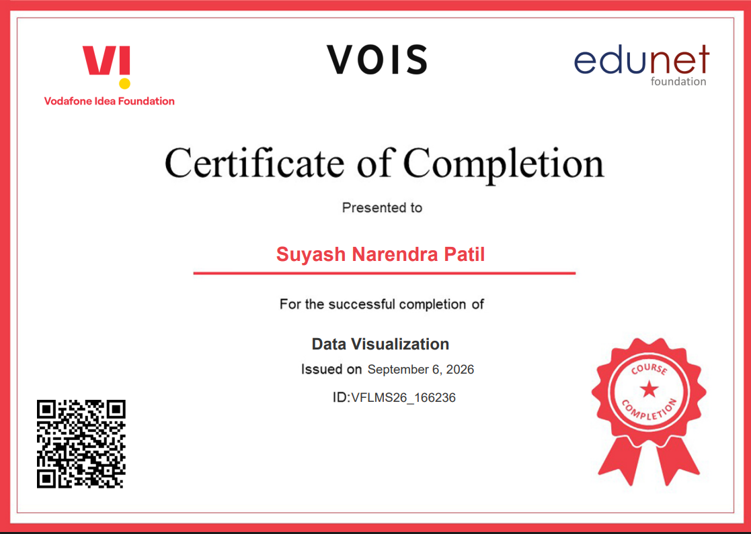
VOIS Course completion certificate - Course name- Data Visualization

Slide 14
Thank you
.
.

